Slide 1




𝖣𝖠𝖳𝖠𝖲𝖤𝖳’25
ECDS
AI GRADER
TEAM NAME: CODE CRACKERS

Slide 2
Problem
𝖣𝖠𝖳𝖠𝖲𝖤𝖳’25
ECDS
Problem Statement:
AI Assignment Grading Assistant

Slide 3
𝖣𝖠𝖳𝖠𝖲𝖤𝖳’25
ECDS
Solution:
An AI-powered assignment grading assistant
Automatically evaluates student submissions
Uses NLP-based similarity and scoring models
Generates basic to advanced feedback
Supports essay-type and descriptive answers

Slide 4
𝖣𝖠𝖳𝖠𝖲𝖤𝖳’25
ECDS
INNOVATION & USP:
Automated grading with minimal human intervention
Rubric-aware evaluation pipelines
Personalized & actionable feedback
Consistent and unbiased grading
Scalable for large classrooms

Slide 5
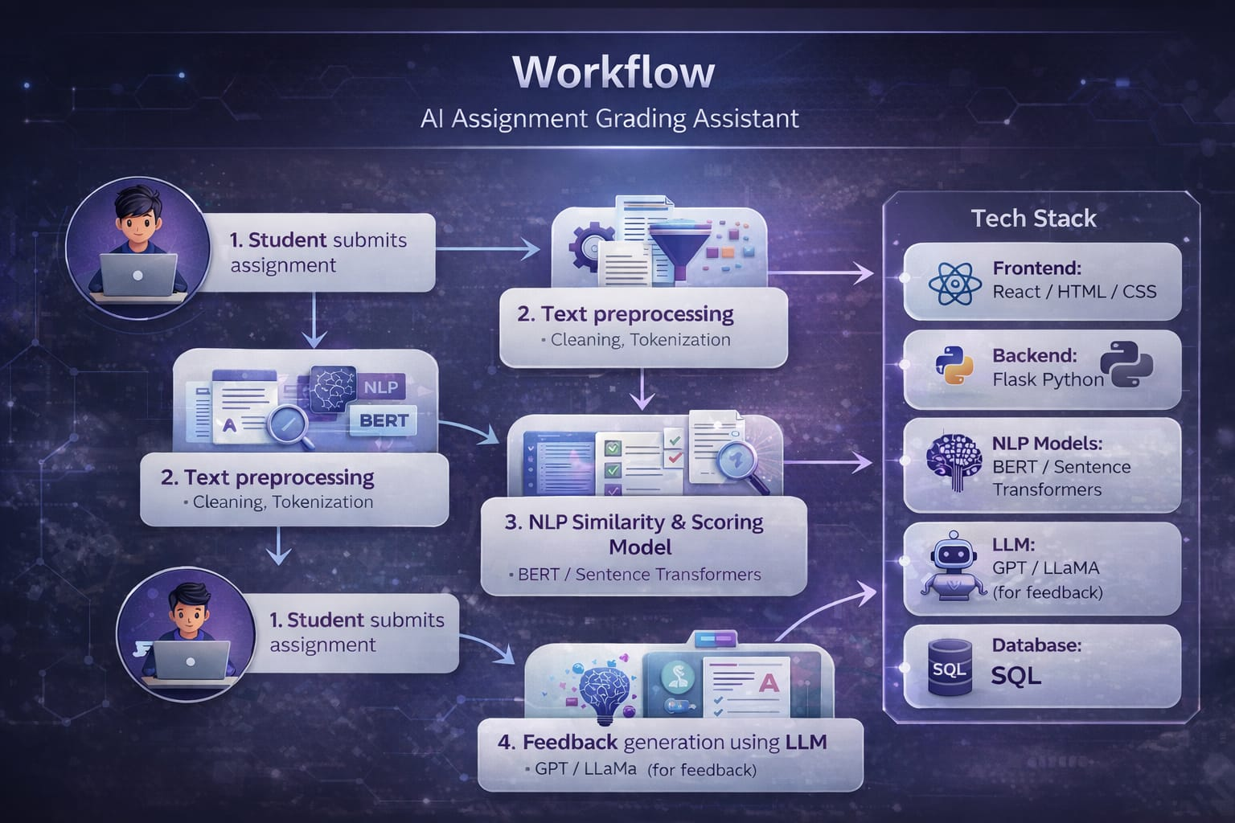
𝖣𝖠𝖳𝖠𝖲𝖤𝖳’25
ECDS

Slide 6
𝖣𝖠𝖳𝖠𝖲𝖤𝖳’25
ECDS
Team members:
S PriyaRakshana – 25MID1065
S Jayshree – 25MID1049
Judith Rubavathy V – 25MID1088
M Gitashri – 25MID1075
Sai Subha Dharshni S – 25MID1065

